Slide 1
Introduction to Information Systems and Programming
Design Patterns

Slide 2
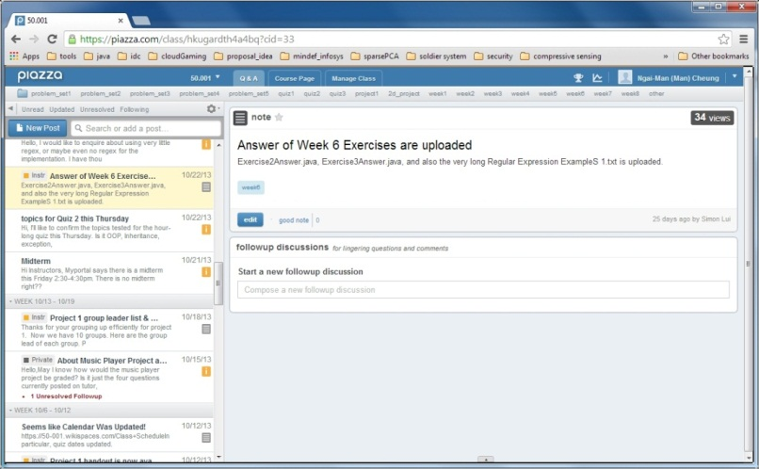
How to design the software?
Example 1: To ensure there is only one instance of an object, available to a number of other classes. E.g., A LogFile class for a pool of applications
Example 2: A message board: whenever a new message is posted to the topic, all the registered observers will be notified

Slide 3
What are design patterns?
How people have organized / designed their program in the past
Best software design solutions that others have encountered
Improve performance
Make it easier to modify the code
Can apply the same principle to your own software design
Solutions to common recurring problems in software design
One of the most valuable tools for developers / software designers

Slide 4
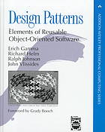
What are design patterns?
Comprehensive OO design pattern discussion:
Erich Gamma, Richard Helm, Ralph Johnson and John Vlissides (Gang of Four, GoF), “Design Patterns: Elements of Reusable Object-Oriented Software” Addison-Wesley 1994.
We will cover:
Singleton
Observer
Visitor (if time permits)

Slide 5
Singleton
To ensure there is only one instance of an object, available to a number of other classes
E.g., Log file for a pool of applications
GoF: “Ensure a class has only one instance and provide a global point of access to it.”
A creational pattern: it is used to construct objects

Slide 6
Singleton
public class Singleton {
private static Singleton instance= null;
private Singleton(){
}
public static Singleton getInstance(){
if (instance == null)
instance = new Singleton();
return instance;
}
}
-Private constructor
-Lazy instantiation: create the instance only when it is used

Slide 7
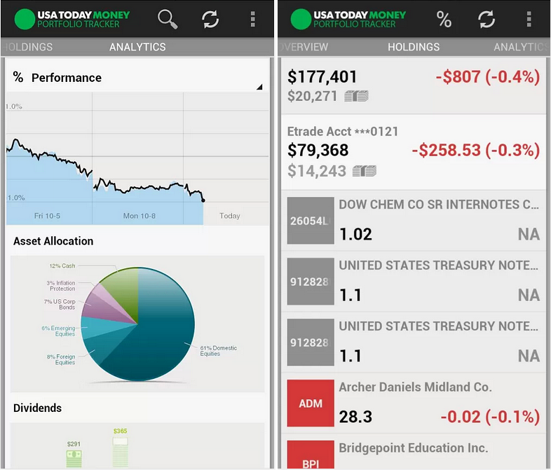
Observer
Useful when you are interested in the state of an object and want to get notified whenever there is any change
Subject (Publisher) maintains a list of its dependents (observers / subscribers)
Subject notifies them automatically of any state changes

Slide 8
Observer
GoF: “Define a one-to-many dependency between objects so that when one object changes state, all its dependents are notified and updated automatically.”
A behavioral pattern: form relationships between objects during execution at runtime

Slide 9
Observer Design Pattern
Subject
Observer
+register(Observer)
+unregister(Observer)
+notifyObservers()
+update()
update()
ConcreteObserver
ConcreteSubject
ConcreteObserver( Subject s):
s.register(this)
+observerList
notifyObservers():
for (Observer o: observerList)
o.update()

Slide 10
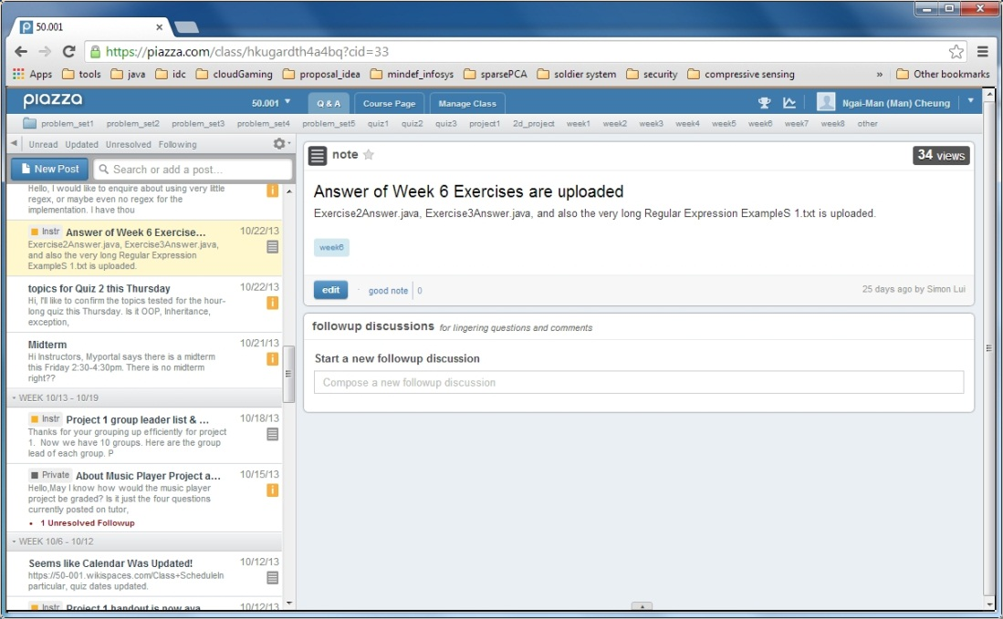
Example: Message board
Subject: a topic
Observers can register to this topic
Whenever a new message is posted to the topic, all the registered observers will be notified

Slide 11
Subject.java
public interface Subject {
void register(Observer o);
void unregister(Observer o);
void notifyObservers();
}
register: call to add a new observer
unregister: call to remover the observer
notifyObservers: inform all registered observers when state change occurs

Slide 12
Observer.java
public interface Observer {
void update(String msg);
}
update: call by Subject to inform Observer a change in state. Different classes of Observer can implement this different to respond to the change in state.

Slide 13
Topic.java
public class Topic implements Subject {
private String message; // the status
private ArrayList<Observer> observers;
public Topic (){
observers = new ArrayList<Observer>();
}
public void notifyObservers() {
for (Observer o: observers)
o.update(this.message);
}
public void register(Observer o) {
observers.add(o);
}
public void unregister(Observer o) {
observers.remove(o);
}
// other features particular to Topic
}

Slide 14
Subscriber.java
public class Subscriber implements Observer {
private String message; // received message
private Subject subject;
public Subscriber(Subject subject){
this.subject = subject;
// register itself to the subject
this.subject.register(this);
}
@Override
public void update(String msg) {
// get update from Subject
this.message = msg;
// do something according to the update
...
}
}

Slide 15
Test.java
public class Test {
public static void main(String[] args) {
Topic topic50001 = new Topic();
Subscriber scott = new Subscriber(topic50001);
Subscriber roger = new Subscriber(topic50001);
topic50001.postMessage("quiz tomorrow !!!");
Subscriber man = new Subscriber(topic50001);
topic50001.postMessage("hw due this wed!!");
topic50001.unregister(man);
topic50001.postMessage("great! man has gone!");
}
}

Slide 16
Why Observer?
Reduce coupling
An object (Subject) needs to share its state with other objects, without knowing who those objects are

Slide 17
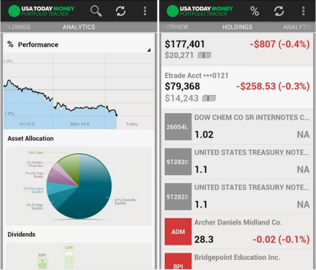
Activity
Using the Observer design pattern, develop a stock alert system that sends alerts to subscribers for any update of the stock prices
Develop StockGrabber class that keeps the list of subscribers for several stock prices, and notifies them for update
Develop StockObserver class that monitors changes in the stock prices
Develop a Test class to simulate the system

